Slide 1
Pembertons of early Virginia
George Washington and our George Pemberton
Why would GW Pay for our GP’s Property- Some thoughts about it

Slide 2
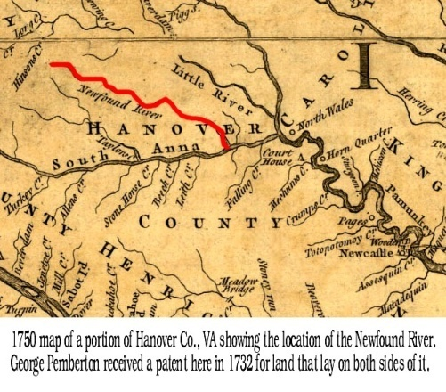
Part Two - Virginia To The Year 1746
Some say that George Pemberton's mother was Francis De Rochelle daughter of George Xavier De Rochelle and wife of John Pemberton. These same sources claim that Francis was baptized in St. John's Parish, Virginia on the same date as John Pemberton's brothers (28 Aug 1679), and that after John's death she married Richard Littlepage and had several children by him. Furthur they state that George Pemberton's middle name was Xavier perhaps in an effort to tie him to George Xavier De Rochelle. None of these sources quote any documents that would go to prove their statements. The use of St. John's parish in Virginia and the date 28 Aug 1679 are almost certainly incorrect for the reasons discussed in Part One. There was a St. John's parish in Virginia, in what would become King William County, but all of it's records were destroyed in the Civil War. George Pemberton's name appears on a number of documents that we will discuss below and in none of these was the name Xavier ever used. It is clear though that he signed his name with an X. Perhaps some well meaning researcher gave him this middle name to relate him to George De Rochelle but there are no documents that show he used the name either. There was a George (de) Rochelle who lived in Virginia in this time frame according to Doris Ross Johnston in a file at Rootsweb World Connect. In her notes for George De Rochelle she states: "by way of Low Countries; shipwrecked off Long Island and the Governor offered them land to settle, but they landed at Princess Anne Co., VA, thence via Nansemond Co., VA to Wake Co., NC -- from thence the SC Rochelles came. SOURCE: Huguenot Soc of TX application of Maggie Smith, Travis Co., 2 Apr 1956“

Slide 3
James Pemberton is the only Pemberton listed among property owners of 25 or more acres in the next census dated 1679, which would seem to indicate the demise of the above mentioned William prior to this date. This census also contained a listing of baptisms and another of burials. Here we find John Pemberton son of James baptized on 9 Aug 1679 and John son of James buried 11 Aug 1679. Two additional sons of James, William and Charles are shown baptized on 28 Aug 1679. James wrote a will on 7 Aug 1701 in which he divided his property into two estates; first the portion located in St. George's Parish he left to his son John and second that in St. John's Parish was left to son Charles. The will states that John was to inherit his share when he reached the age of 21 and Charles on the death of James' wife Rebecca.
Our main concern is with John Pemberton bp 9 Aug 1679 and whether or not he could be the same person as John Pemberton of Virginia and father of George described in many different Pemberton family histories and other references. The dates 9 Aug 1679 and 28 Aug 1679 are given in one account by Mr. Eli Jay who wrote:
"We do find this name in the early records of St. John's Parish in Virginia when on August 9, 1679 John Pemberton, son of James was baptized and on August 28 of the same year, William and James Pemberton, sons of James.....".
There can be little doubt that Mr. Jay and other writers were incorrect in assuming that John Pemberton of Virginia was one and the same person as the John Pemberton of Bardados:
1. The Census of 1679 shows a John was buried on 11 Aug 1679.
2. The John mentioned in James' will is referred to as a minor in 1701 which clearly rules out the possibility that John bp 9 Aug 1679 could be the same person.
3. If the John of Virginia was the John bp 9 Aug 1679 then, unless he was baptized at a very advanced age, how could he have been able to execute a real estate transaction with Mr. Richard Littlepage, Sr. who died 20 Apr 1688 a little more than 7 years later? (See deed of 20 Jan 1702.)
4. The records of St. John's parish were destroyed in the Civil War 40 plus years before Jay wrote his account.
We can find no reasonable way to link the Pembertons of Barbados to those of Virginia however we will include them in our file as an unlinked family beginning with William Pemberton.

Slide 4
1. E.L Pemberton, elpemberton@qwest.net, Facts on Pemberton Ancestry Barbados, West Indies, December, 1982. , "Another bit of research that I became involved in back in 1982 was a trip to Barbados to check on the Baptisms of the John, William and Charles Pemberton reported in several books on Pembertons. I also visited the Parish of St. John in Barbados. From the Barbados Department of Archives there are positive records showing the 1679 Census of Baptisms for St. John Parish. This gives the dates of August 9 for John, sonne of James Pemberton and August 28 for William and Charles, sonns of Mr. James Pemberton" 2. FamilySearch™ International Genealogical Index v4.02 - Carribean Islands -------------------------------------------------------------------------------- Frances DEROCHELLE Sex: F Birth: 1677 <st. John's Parish>, Antigua, Caribbean Father: George Xavier DEROCHELLE Mother: Film Number: 1761010 Page Number: Rwference Number: Frances DEROCHELLE Sex: F Spouse: John PEMBERTON Marriage: Abt. 1698 <st. John's Parish>, Antigua, Caribbean Film Number: 1761034 Page Number: Reference Number: George Xavier PEMBERTON Sex: M Birth: 1699 <st. John's Parish>, Antigua, Caribbean Father: John PEMBERTON Mother: Frances DEROCHELLE Film Number: 1761034 Page Number: Reference Number: John PEMBERTON Sex: M Christening: 9 Aug 1679 St. John's Parish, Antigua, Caribbean Father: James PEMBERTON Mother: Film Number: 1761034 Page Number: Reference Number:

Slide 5
There is a John Pemberton found in the old property records of King William County, Virginia who might be George's father. This John Pemberton was in Virginia prior to, 20 Apr 1688, when he paid to Richard Littlepage, Sr., as executor for the estate of Samuel Osteen (also spelled Ostin or Austin), a sum of 2600 pounds of tobacco and some cash for 184 acres of land located in Pamunkey Neck. At some point prior to 20th of January, 1702/3 John passed away and Richard Littlepage, Jr., deeded the above land to John's son George Pemberton. In 1732 George received three Colonial Land Patents totaling 1180 acres. On 5 Nov 1734 he transferred something to a Jno Garth. In 1738 he received another patent for an additional 416 acres. All of this property lay in what is now Hanover County which was formed in 1720 and was probably near his original 184 acres. One of the tracts acquired in 1734 lay on both sides of the Newfound River (see map above) and we believe his other property was either adjacent to this or nearby. The question of whether this George was one and the same person as the George who lived and died in what is now Jefferson Co., WV must be addressed. According to E.L. Pemberton:
"A question I have is if you have some documentation on whether the George living in King William County and identified on this deed in 1702 is the same George who died in Winchester, Frederick Co. in 1757 ? I was never able to find this link through the usual search of all possible reliable records of baptisms, church records, marriages, abstracts, deeds, wills, military records, and official documents prior to the census. There is the one record in the William and Mary Quarterly of a Geo. X Pemberton, of St. Martins P. in Hanover Co. making some payment to a Jno Garth of St. Martins P. on Nov. 5, 1734. I am aware that Mary Helen Pemberton made the assumption the two Georges were the same. You can probably gather by now that I am a little skeptical of many of her assumptions. Also, there is considerable distance from the Richmond, VA area to Winchester, VA. Another question is on the age of George Pemberton in the deed who was apparently old enough to make a motion it be admitted to record. It would be nice to find some record of when John Pemberton acquired the land and his age. [EMail dated 6 Dec 2000]

Slide 6
Reverend Daniel Brown of Culpepper County, Virginia and Allied Families Compiled by Colonel Woolsey Finnell, Sr., Tuscaloosa, Alabama, during the period 1948 - 1954.
P. 62 In his Chapter on the Pembertons, the author states that “We have a
Record of ten families of Pembertons in King William Parish early in the 18th century.
Who were these 10 families?

Slide 7
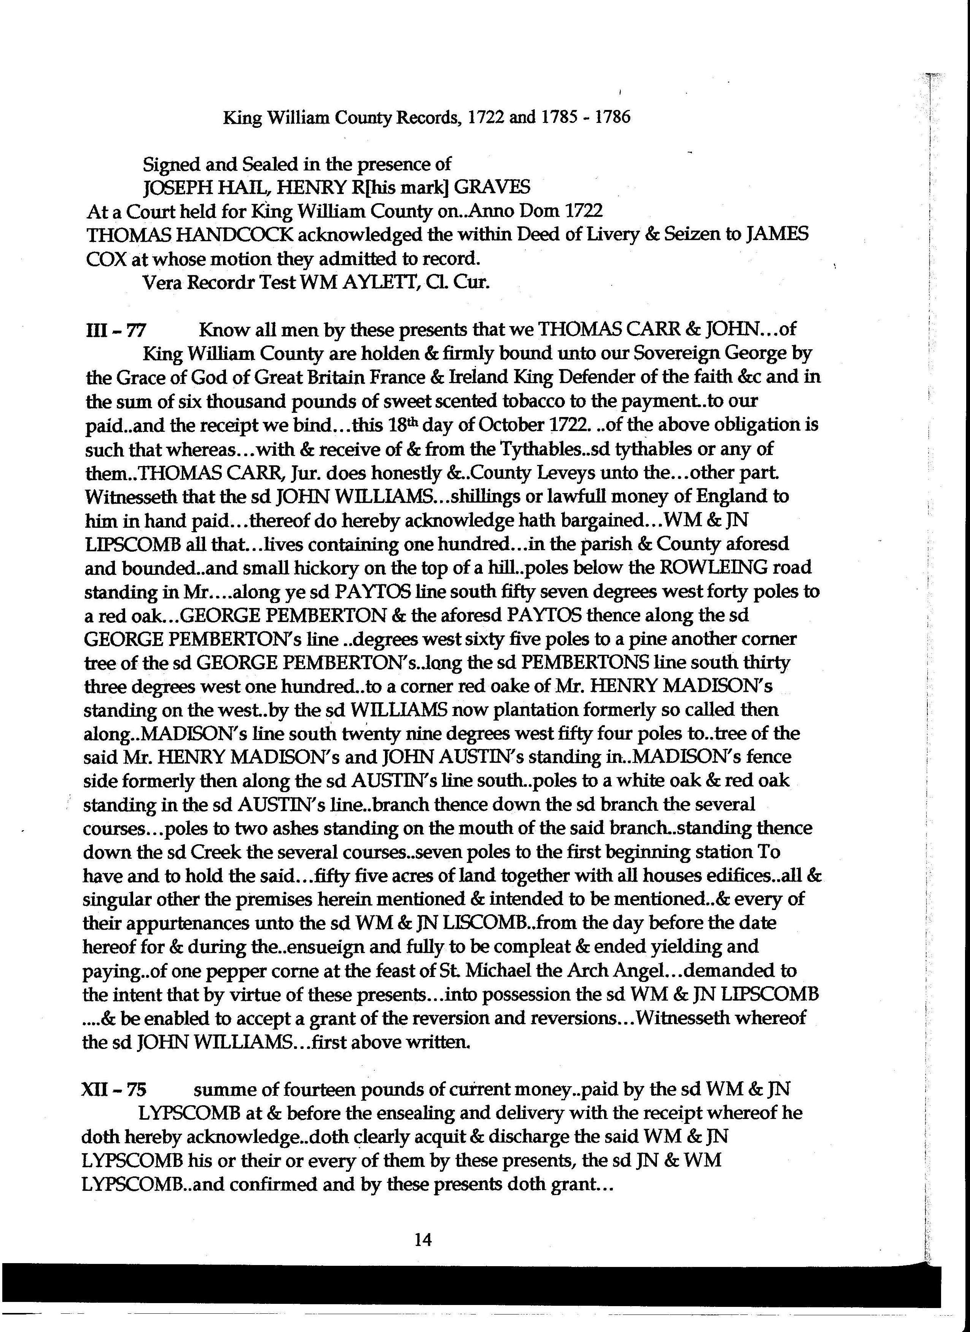

Slide 8
George Pemberton in court in Virginia
In the Executive Journals of the Council of Colonial Virginia, we read this on or about 20 October 1732: "Ambrose Joshua Smith having petitioned for a Grant of 400 Acres of Land lying on the northside of Newford River & joyning to the Lands of Capt. Crawford & Benja Saunders Sur- vey'd in the Year 1727 for George Pemberton who hath neglected to Sue out a Patent for the same It is ordered that the s d Pem- berton be sumoned to attend this Board at the next Court of Oyer & Terminer to answer the said Petition."

Slide 9
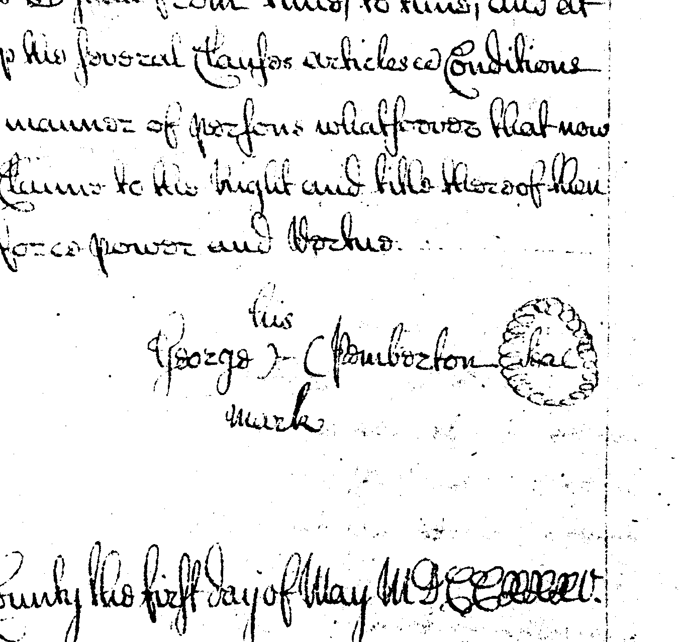

Slide 10
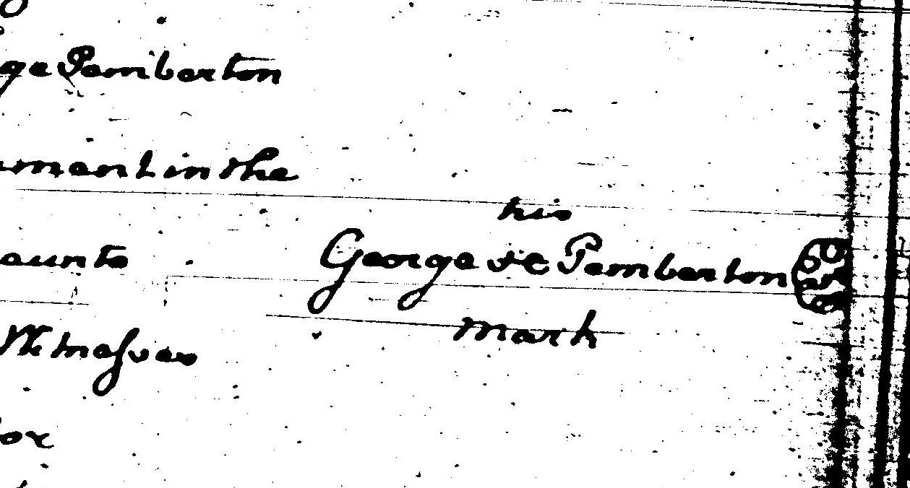

Slide 11
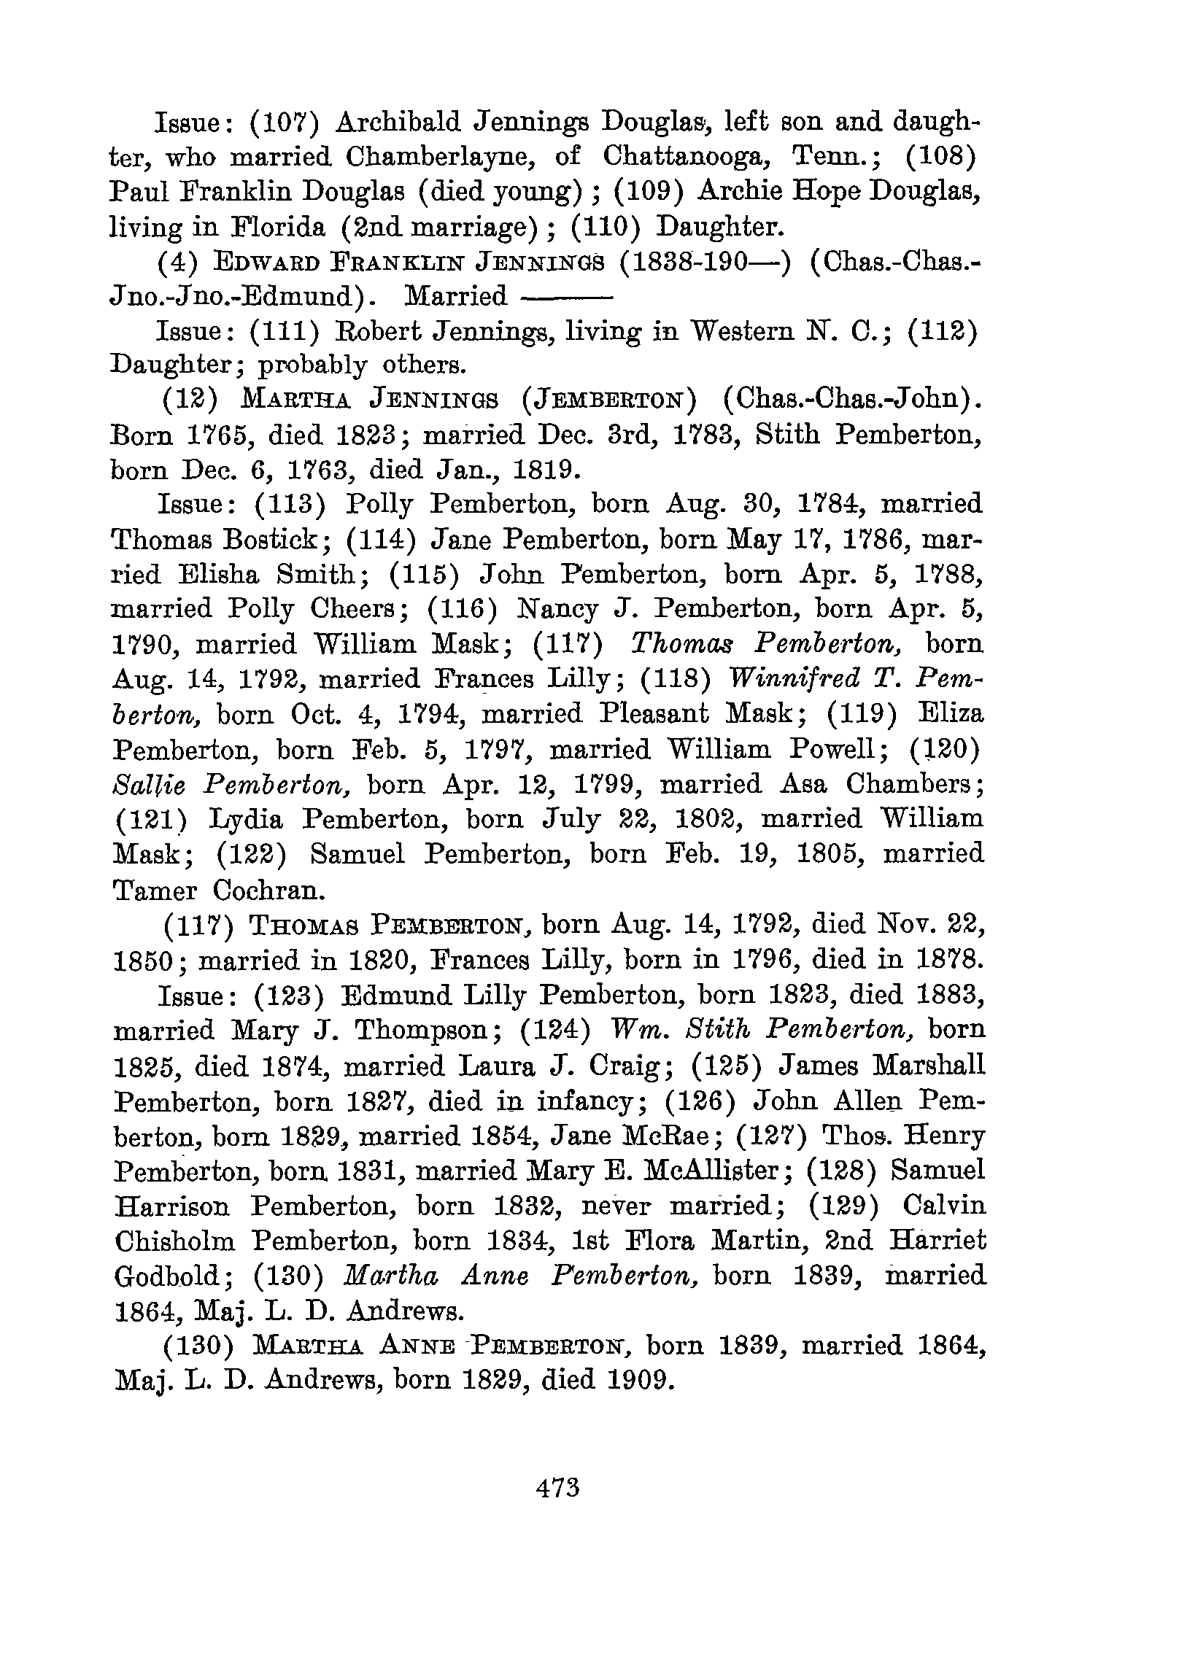

Slide 12
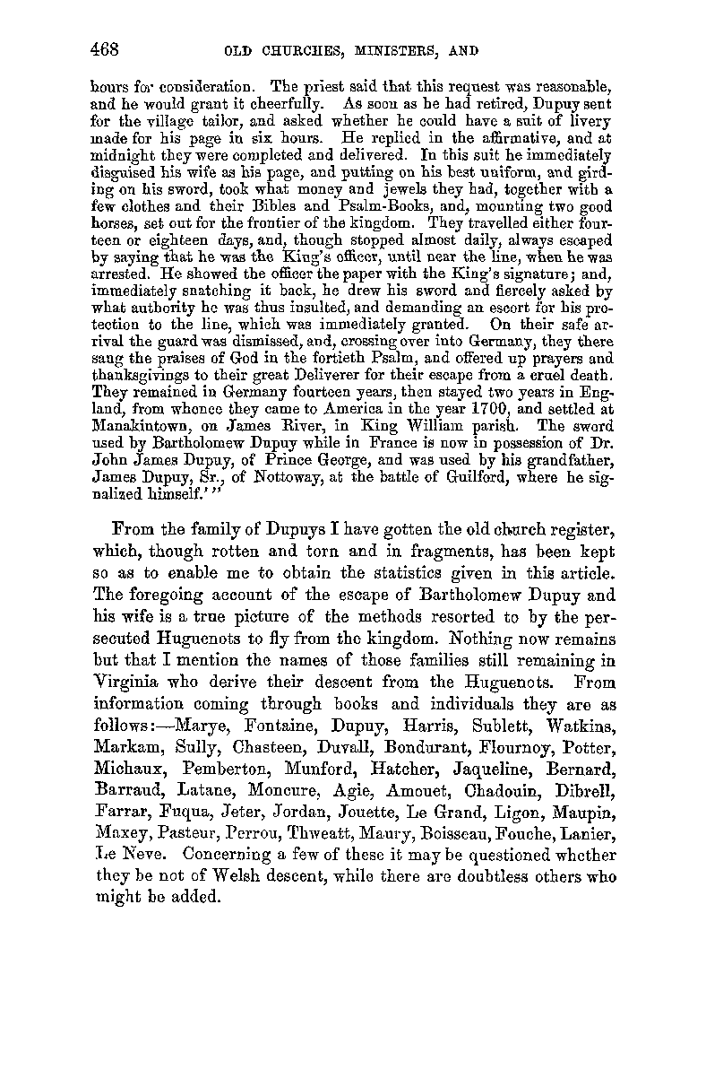

Slide 13
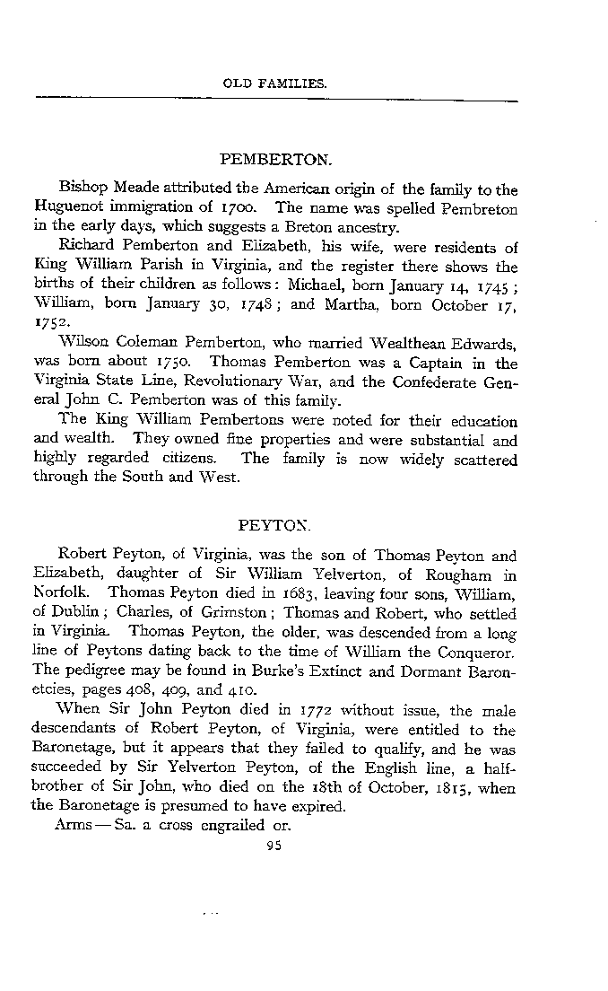

Slide 14
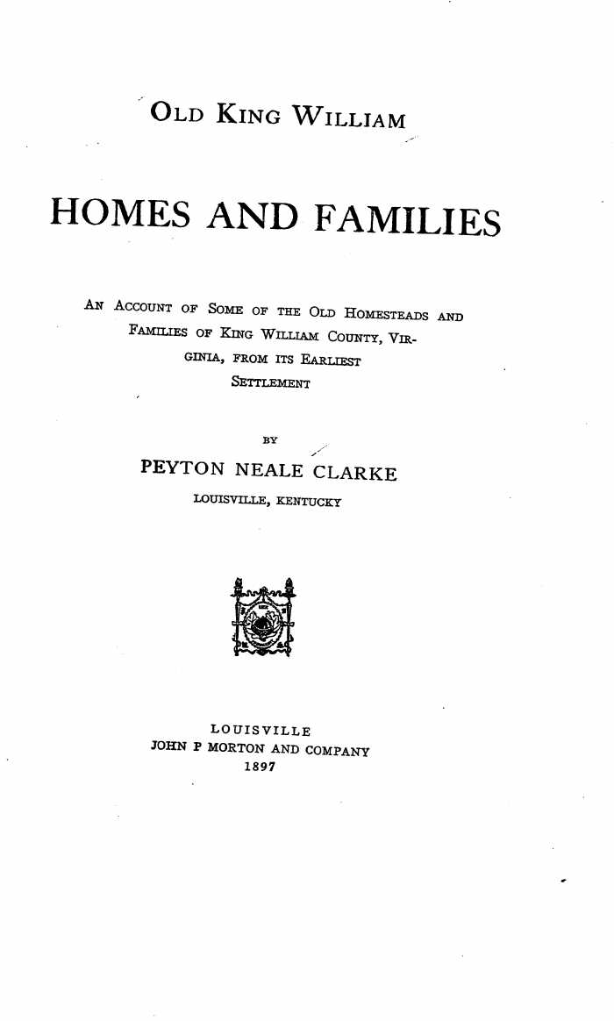

Slide 15
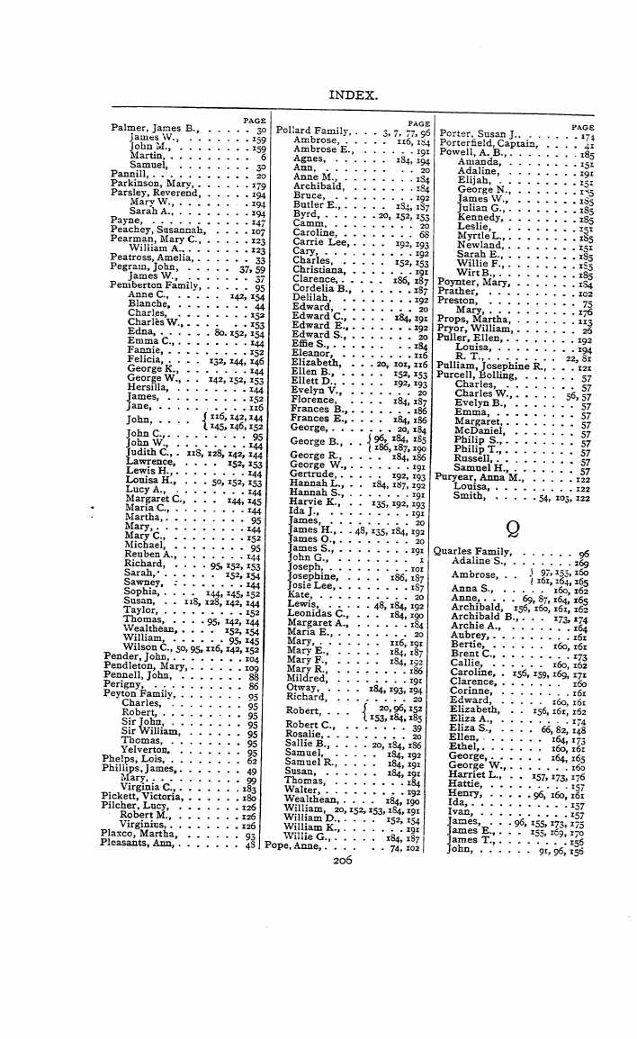

Slide 16
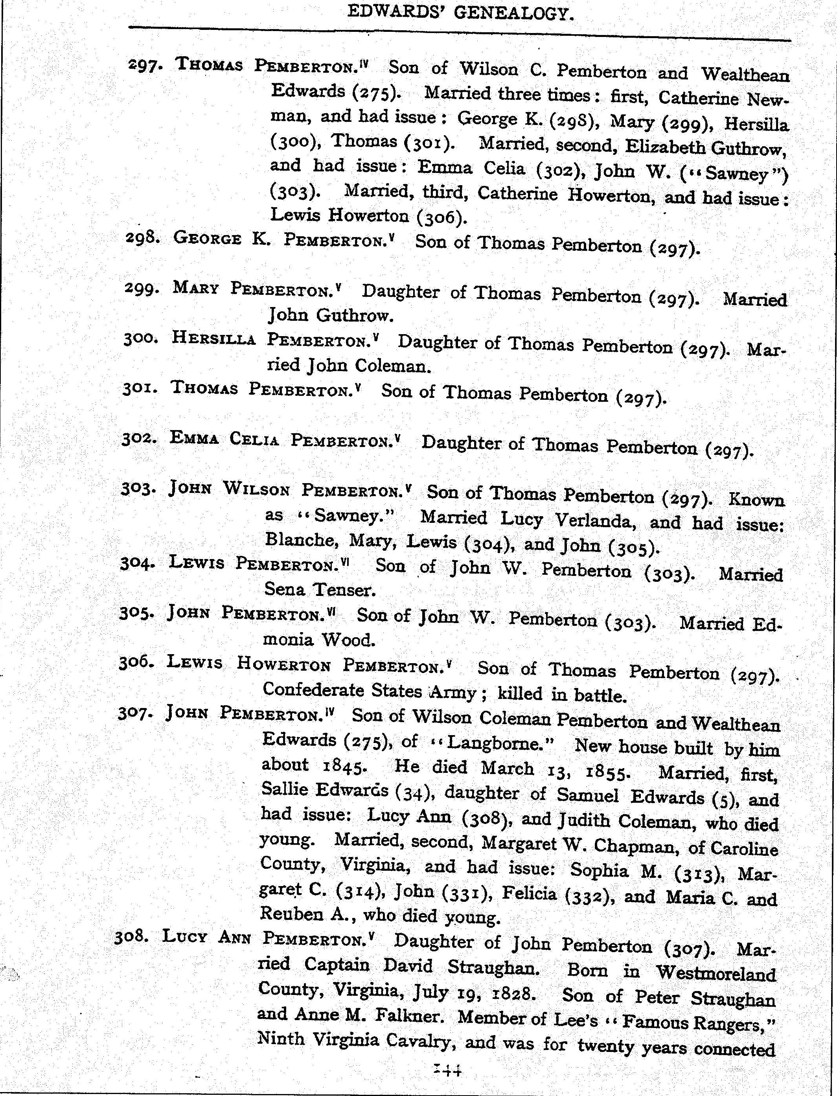

Slide 19
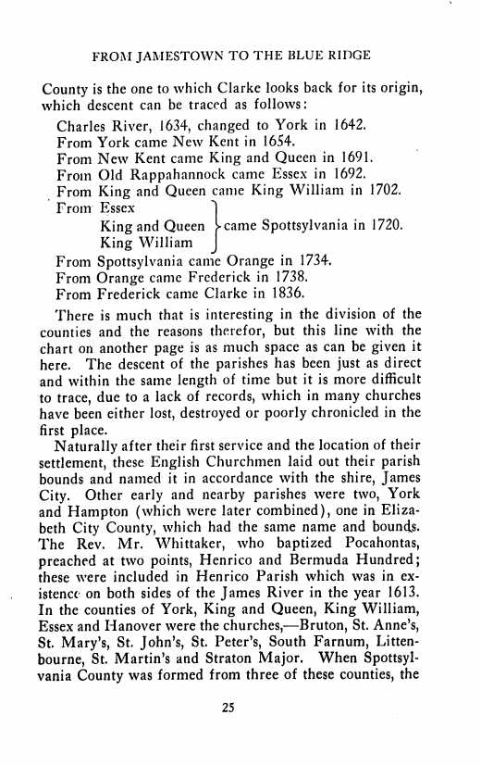

Slide 22
Did President George Washington know George Pemberton II? Or his sons George and Isaiah?
This is a question posed by James Lloyd in our Pemberton Post, November 26,2011 in his article: Mr. Washington’s Order.
In 1771, brothers George and Isaiah sold their property to Samuel Washington, George Washington’s brother. For this we have records.

Slide 23
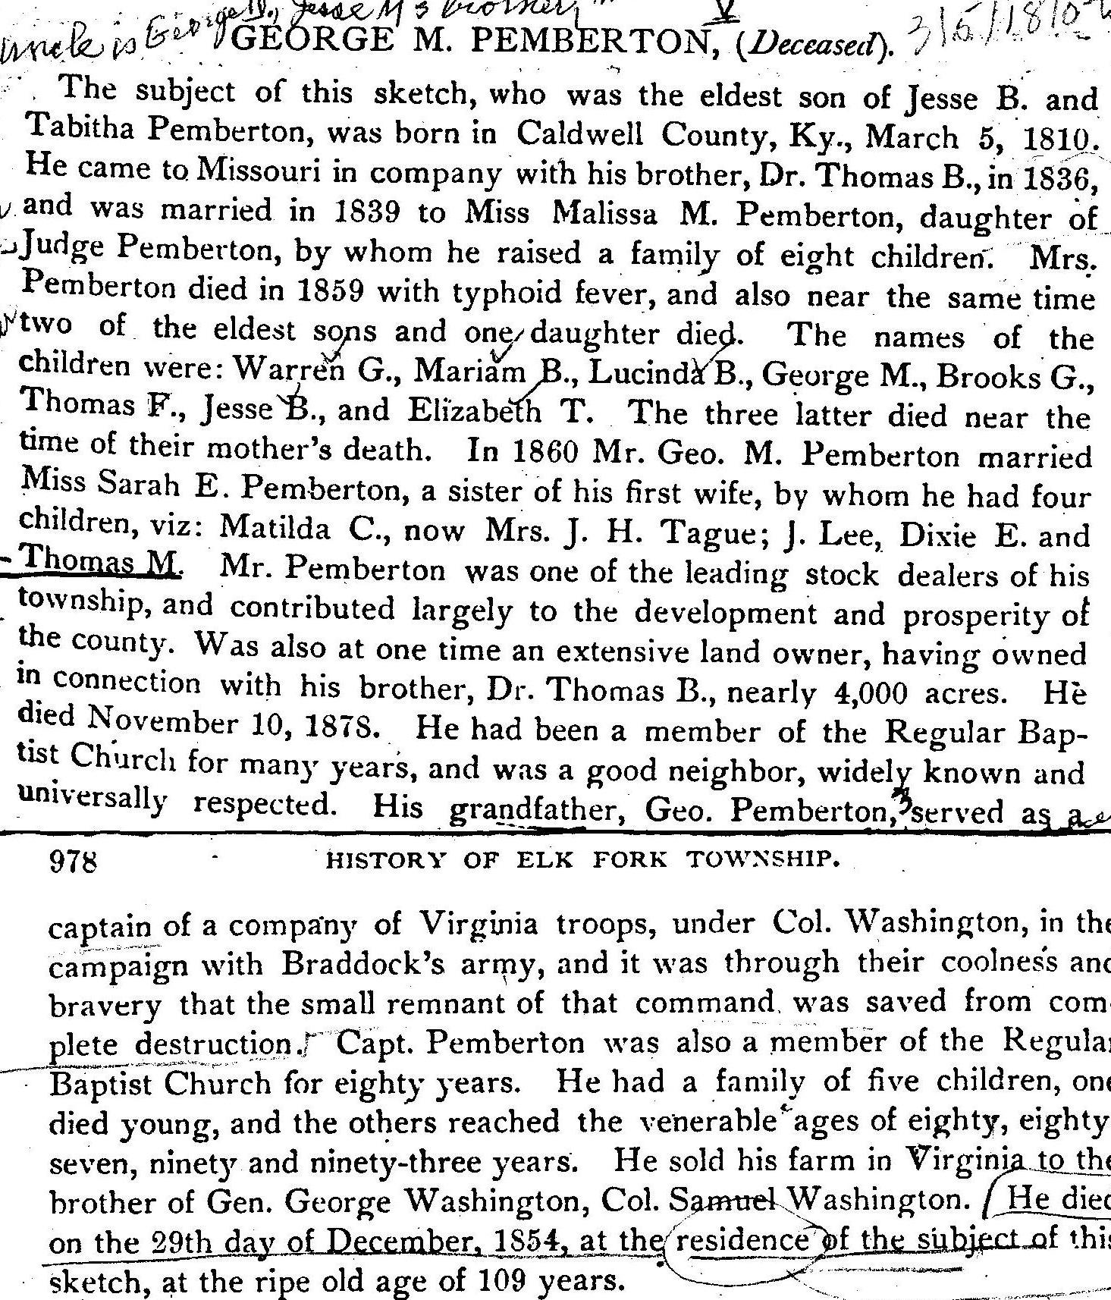

Slide 24
Battle: Braddock’s defeat on the Monongahela River
War: The French and Indian War also known as the Seven Year War (1755 to 1762)
Date: 7th July 1755

Slide 25
Braddock’s defeat? Blackstocks RW Battle? Or, neither?

Slide 26
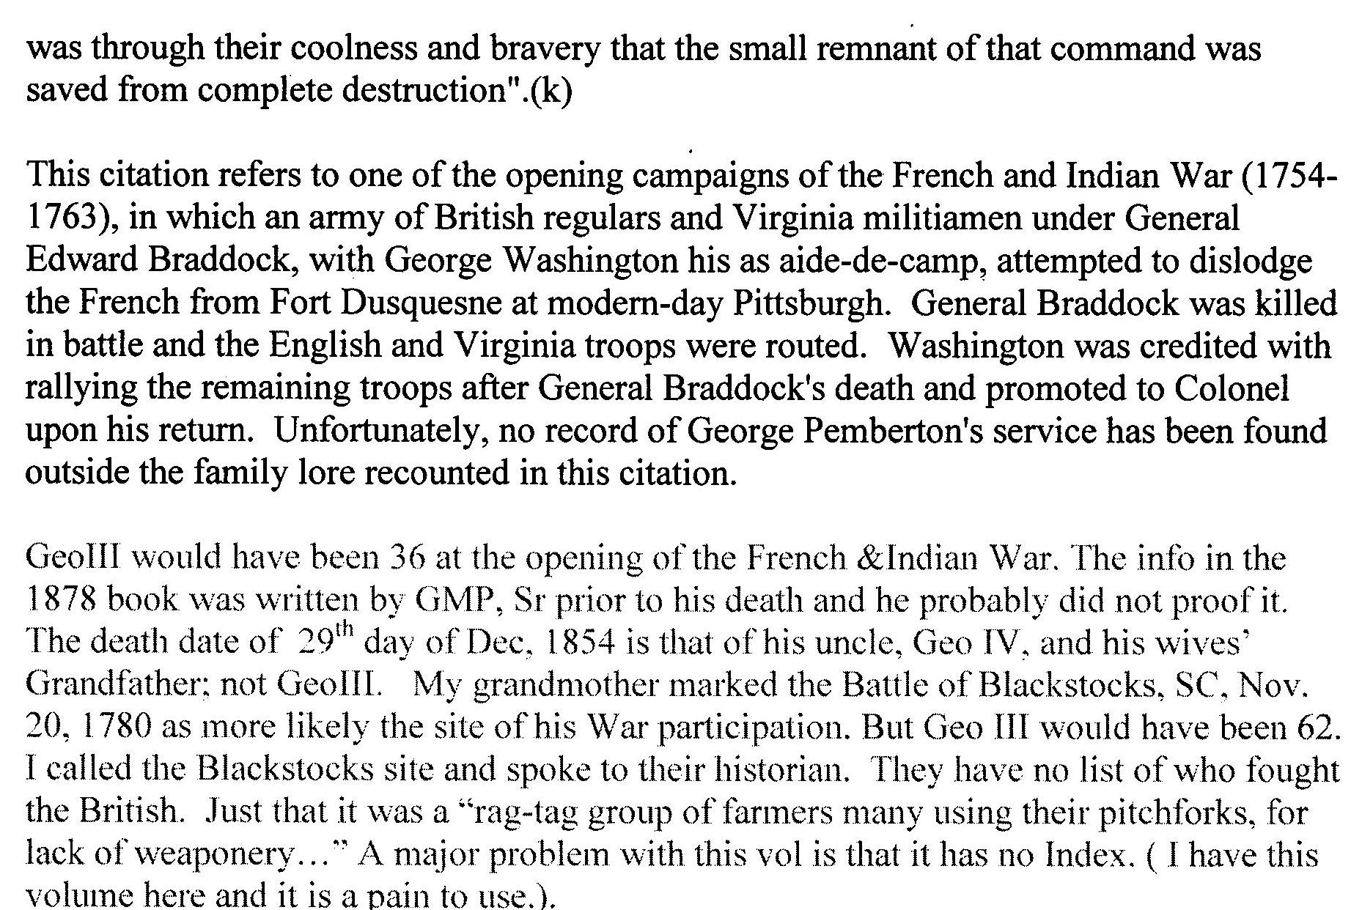

Slide 27
Why would GW Pay for our GP’s Property- Some thoughts about it
*Property survey and payment, 1750
*Not for aid at the Battle led by Braddock, death 1755
*Not for fight at Blackstocks, SC, 1780
*Maybe because, like the Carney’s land it adjoined the Washington’s, and there were expectations regarding future ownership, speculates James Lloyd in his article: Mr. Washington’s Order, Pemberton Post, 11/26/11

Slide 28
So at this point we have identified several Georges who might be one and the same a our George of Jefferson Co. W.V. But as Ernie states: “ there is no evidence to tie any of them to him (Our George).”
Fortunately for us in 2003 we received a copy of the scrapbook of George M. Pemberton that, we believe, points to the real George. Part Three will discuss this important document in detail.
From G. Daniel P. Buckley’s website
How many Pemberton Families in Early Virginia did you count in part I?

